Slide 1
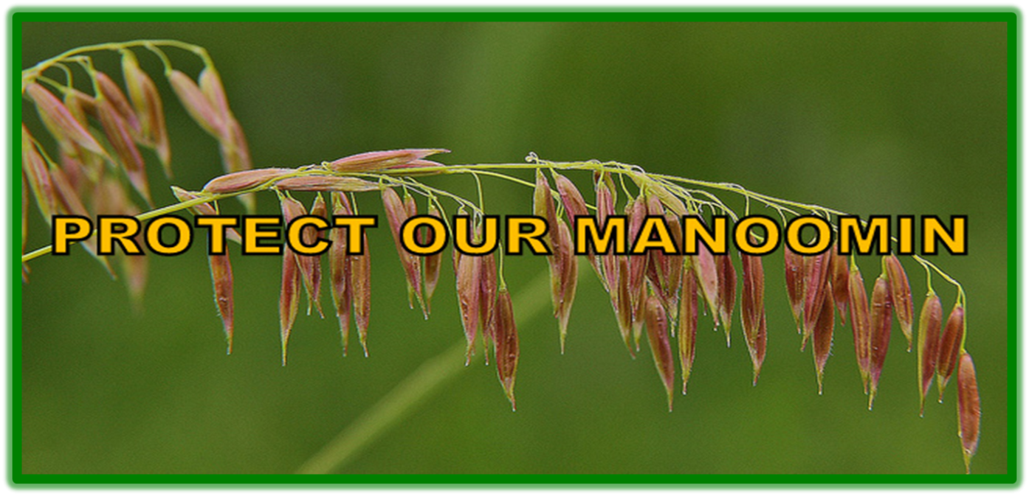
For the Present Generation to the Seventh Generation

Slide 2
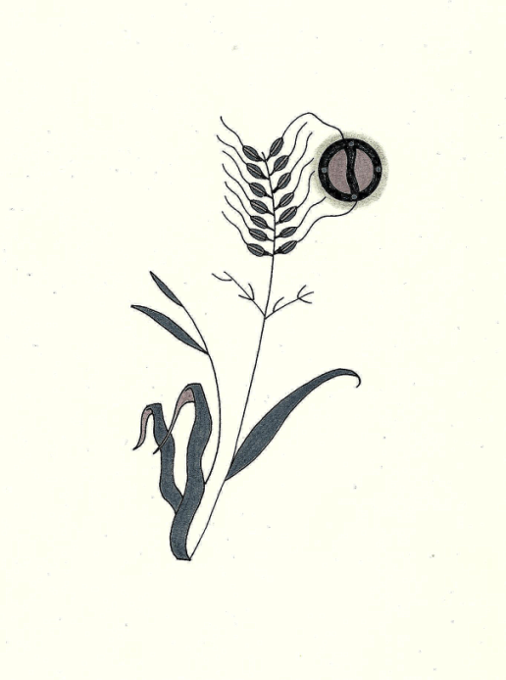
Protect Our Manoomin believes that manoomin (natural wild rice) is a sustenance gift from the Gichi-Manidoo (the Creator). In this respect, the sustenance right to manoomin is sacred and cannot be constrained or recalled by colonial laws, policies, or institutions that impact and imperil the manoomin gitigaanan (natural wild rice stands) and ecosystem in northern Minnesota. We are resolved, as Bamaadizidjig (Anishinaabeg, non-Anishinaabeg, and non-Native peoples), to resist any changes that endanger our manoomin. We seek to create awareness of sulfate and sulfide pollution via mining and its harmful effects on manoomin – a vital cultural, spiritual, and environmental resource. We are guided by the Anishinaabe gete-gikendaasowin (traditional knowledge) of our elders.

Slide 3
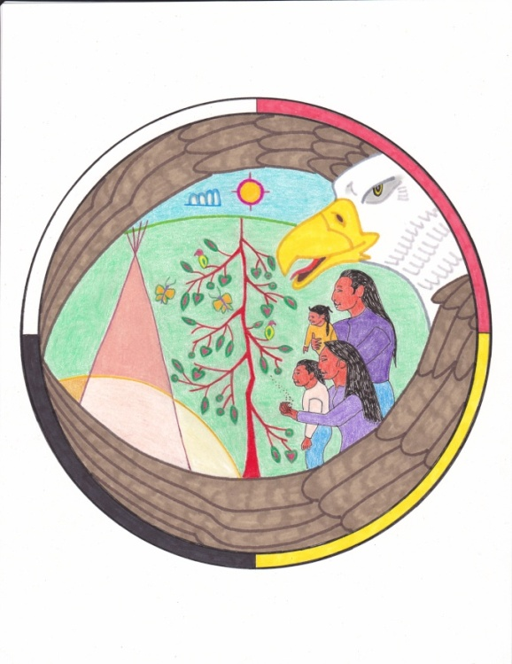
Environmental ethics is a branch of applied ethics and a part of environmental philosophy. It developed out of three insights: first, that ethics cannot be built without the consideration of natural beings, nature, or the Earth because all beings on Earth are interconnected; second, that the scope of ethics should include future consequences, and so ethics should have an inter-generational outlook; third, that proper ethics cannot be built without recognizing that human life is only possible given the proper condition
of the Earth.

Slide 4
Two Schools of Thoughts – Environmental Ethics
One theory says that our responsibility to the natural environment is only an indirect one and is based on our responsibilities to other people. This school of thought is definitely human-centered or anthropomorphic . While it argues that we have some sort of responsibility to the environment, it says that this responsibility is not a direct one and that the focus is on how the condition of the environment affects people, both in present and in future generations. In other words, we have a duty to make sure that Earth stays in good enough shape so that human life is supported. Some call this school of thought or philosophy "shallow ecology.“
A different school of thought is described as nonanthropomorphic, which means that all forms of life have an intrinsic (essential or basic) right to exist in the natural environment. This point of view gives what is called "moral standing" to animals and plants, and argues that they, like humans, are to be considered "morally significant persons." This philosophy is called "deep ecology." It states that humans have a direct responsibility toward maintaining the environment for all forms of life.

Slide 5
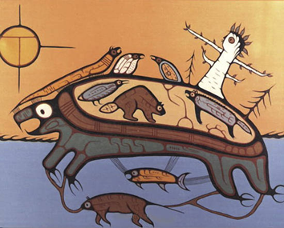
Environmental Ethics of the Anishinaabeg
The elders say that Gichi Manidoo (the Creator) created the world in a certain order; first, the physical world of sun, moon, earth, and stars; second, the plant-beings - trees, flowers, grasses, and fruits. Plants are therefore prior to animals and to the Anishinaabeg. They can exist alone; they are not dependent upon other beings for their existence or well-being.
In essence each plant-being of whatever species is a composite being, possessing an incorporeal substance, its own unique soul-spirit. It is the vitalizing substance that gives to its physical form, growth, and self-healing.
After plants, Gichi-Manidoo created animal beings conferring on each special powers and natures. These were the two-legged, four-legged, winged, and swimmers.
Last of all, Gichi-Manidoo made human beings. Last in the order of dependence, Humans cannot exist without the other three, although Aki (Mother Earth, the plant beings, and animal beings can exist without human beings.

Slide 6
Four Orders of Life
Anishinaabeg
Human-Beings
Awesiinhyag
Animal-Beings
Aki
Mother Earth
Gitigaanan
Plant-Beings

Slide 7
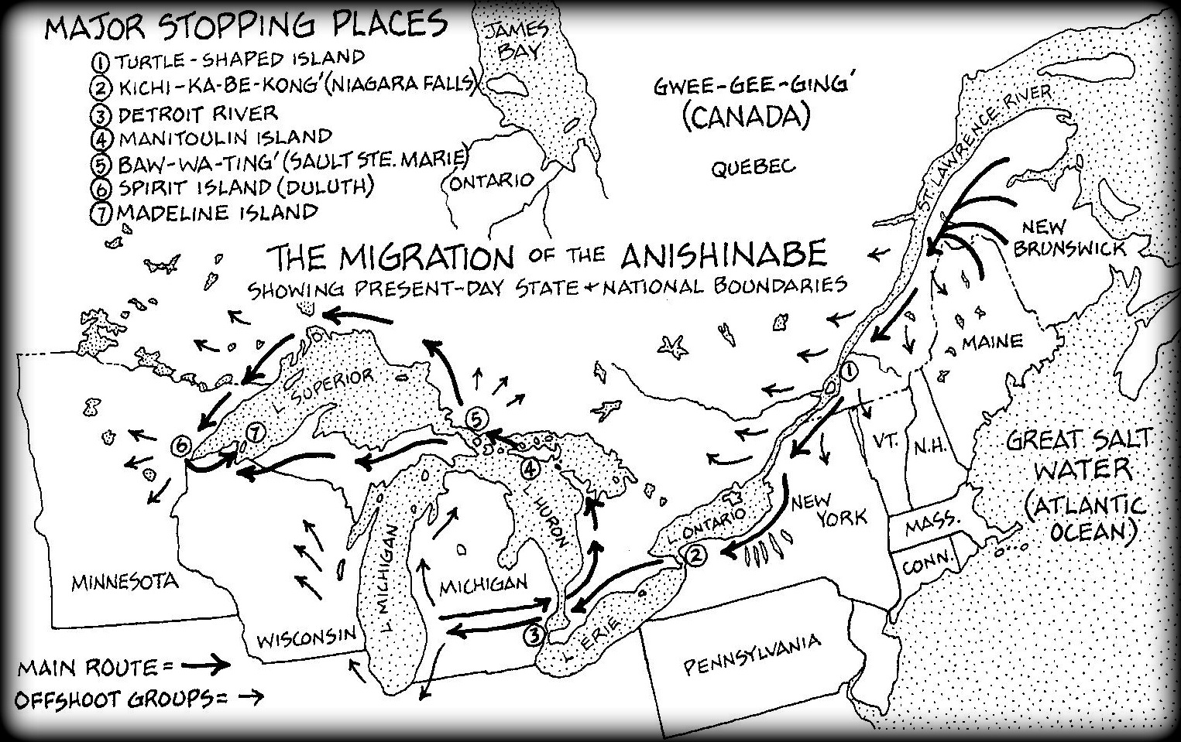
Chi-be-moo-day-win
(The Great Migration)

Slide 9
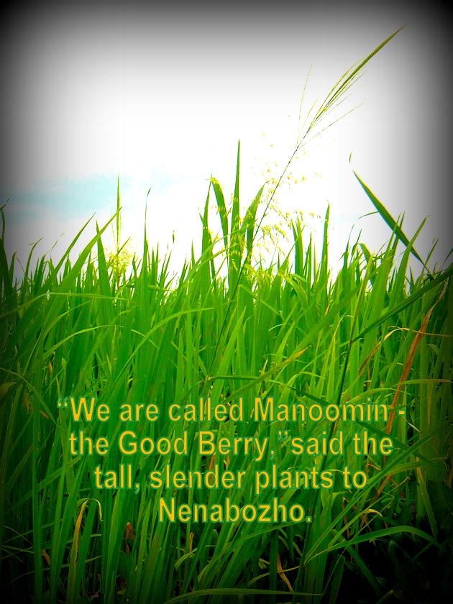

Slide 10
Anishinaabe Environmental Ethics Regarding Manoomin
1. As a living being, manoomin has the following inherent rights: a. the right to life and to exist; b. the right to be respected; c. the right to regenerate its bio-capacity and to continue its vital cycles and processes free from human disruptions; d. the right to maintain its identity and integrity as a distinct, self-regulating and interrelated being;
e. the right to clean, sacred nibi as a source of life; f. the right to integral health; g. the right to be free from toxic pollution resulting from sulfide mining; h. the right to not have its genetic structure modified or disrupted in a manner that threatens its integrity or vital and healthy functioning. 2. Manoomin has the right to a place and to play its role in Omizakamigokwe (Mother Earth) for her harmonious functioning.

Slide 11
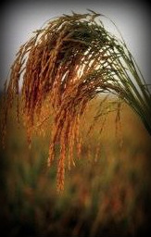
Manoomin and the Ecosystem
Manoomin is an environmental resource. Healthy stands of manoomin are the barometer of a healthy ecosystem. Macroinvertebrates, vegetation, flora, fish, waterfowl, wetlands and wildlife are all interconnected in the ecosystem of manoomin. Manoomin protects water quality, reduces algae blooms, and provides habitat for fish, mammals and wildfowl.
Manoomin stands serve as resting, foraging, nesting, and brood rearing sites for both migratory and resident water birds. It is one of the most important and nutritional foods for waterfowl in Minnesota. From early May to late November, ducks, geese, and other water birds feed on the sprouting seeds, young shoots, and ripe grain. More than 35 species of shore birds and wading birds have been observed using manoomin fields.

Slide 12
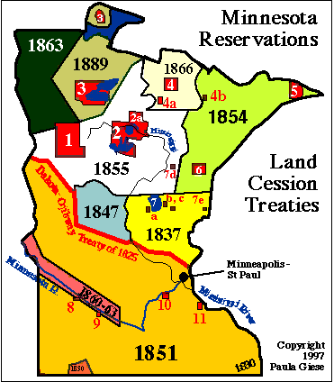
Treaty of 1854 established the 1854 Ceded Territory. Reservations within the 1854 include Fond du Lac, Grand Portage, and Bois Forte.
Treaty of 1855 established the 1855 Ceded Territory.
Reservations include Leech
Lake and White Earth.
The Mille Lacs Ojibwe 1837
Ceded Lands was affirmed
by the Supreme Court
Decision in 1999.

Slide 13
Understanding Reserved Treaty Rights
In 1837, the Anishinaabe Bands in Minnesota and Wisconsin negotiated a treaty at St. Peter, Minnesota. Anishinaabeg leaders maintained usufructuary rights with the lands that were ceded. These usufructuary rights, i.e., reserved treaty rights, included
hunting, fishing, and gathering rights.
As cited in the Treaty of 1837: ARTICLE 5 - The privilege of hunting, fishing, and gathering the wild rice, upon the lands, the rivers and the lakes included in the territory ceded, is guarantied to the Indians, during the pleasure of the President of the United States.
In 1854 and 1855, treaties were negotiated that further diminished ceded lands and created present-day reservations. However, the reserved treaty rights of the 1837 Treaty were maintained. These rights were affirmed by the Voigt Decision in 1983 (Lac Courte Orielles Band v. Voigt v. Wisconsin) and the Supreme Court decision in 1999 (Minnesota v. Mille Lacs Band).

Slide 14
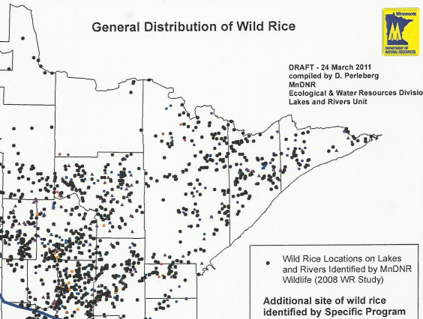
1855
Ceded Land
Area
1854
Ceded Land
Area
There are over 64,000 acreage of manoomin in Minnesota. The combined total of 48,00 Manoomin acreage is located within the 1854 and 1855 ceded lands.

Slide 15
An Anishinaabeg Historical Perspective
One of the Ogimaa on Madeline Island kept a special ozawabik (copper medallion) in his sacred Mide bundle. The medallion was carefully made by his grandfathers from a copper deposit found on the shore of Anishinaabe-Gichigami (Lake Superior). His grandfathers had carved a notch on the edge of the medallion when the Anishinaabe first settled on Madeline Island. The medallion was then kept by a member of the family until he/she passed into the Spirit World. Then the medallion was handed down to one of the members of the younger generation. A new notch was carved on the medallion and it was carried again for another lifetime. In this way a record was kept of the generations that lived on Madeline Island.
By the third notch carved on the copper disc was also inscribed the figure of a man wearing a large hat. It is believed that this represents the time in which the Anishinaabe of Madeline Island heard of the arrival of the Light-Skinned Race.
~ The Mishomis Book

Slide 16
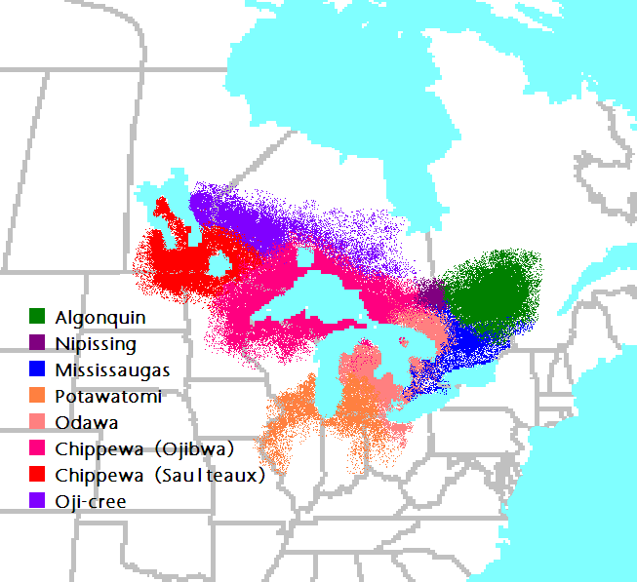
In the late 1600s, the French were active in exploring for copper deposits in the Lake Superior region. The Anishinaabe were one of several Lake Superior indigenous peoples who mined for copper before the arrival of Europeans. The locations of copper deposits were never revealed to the French, however, they were successful in obtaining copper specimens.
In 1826, a treaty was negotiated with the Anishinaabe at Fond du Lac, Minnesota. The treaty was not for the cession of tribal lands; rather it was a census treaty by the U.S. to identify the various bands within the Ojibwe Nation. However, the U.S. included a provision in the treaty: ARTICLE 3 - The Chippewa tribe grant to the government of the United States the right to search for, and carry away, any metals or minerals from any part of their country. But this grant is not to affect the title of the land, nor the existing
jurisdiction over it.
Basically, the so-called “copper” provision allowed mining companies to conduct exploratory surveying of Anishinaabe land. Less than twenty years after the treaty was ratified, copper mining opened in the Upper Peninsula of Michigan.
Today, in an area that was once abundant with manoomin, nearly 160 years of copper mining in Michigan has impacted manoomin to the extent that only one lake produces manoomin. Toxins from the old, abandoned mines in Michigan continue to pollute Lake Superior.

Slide 17
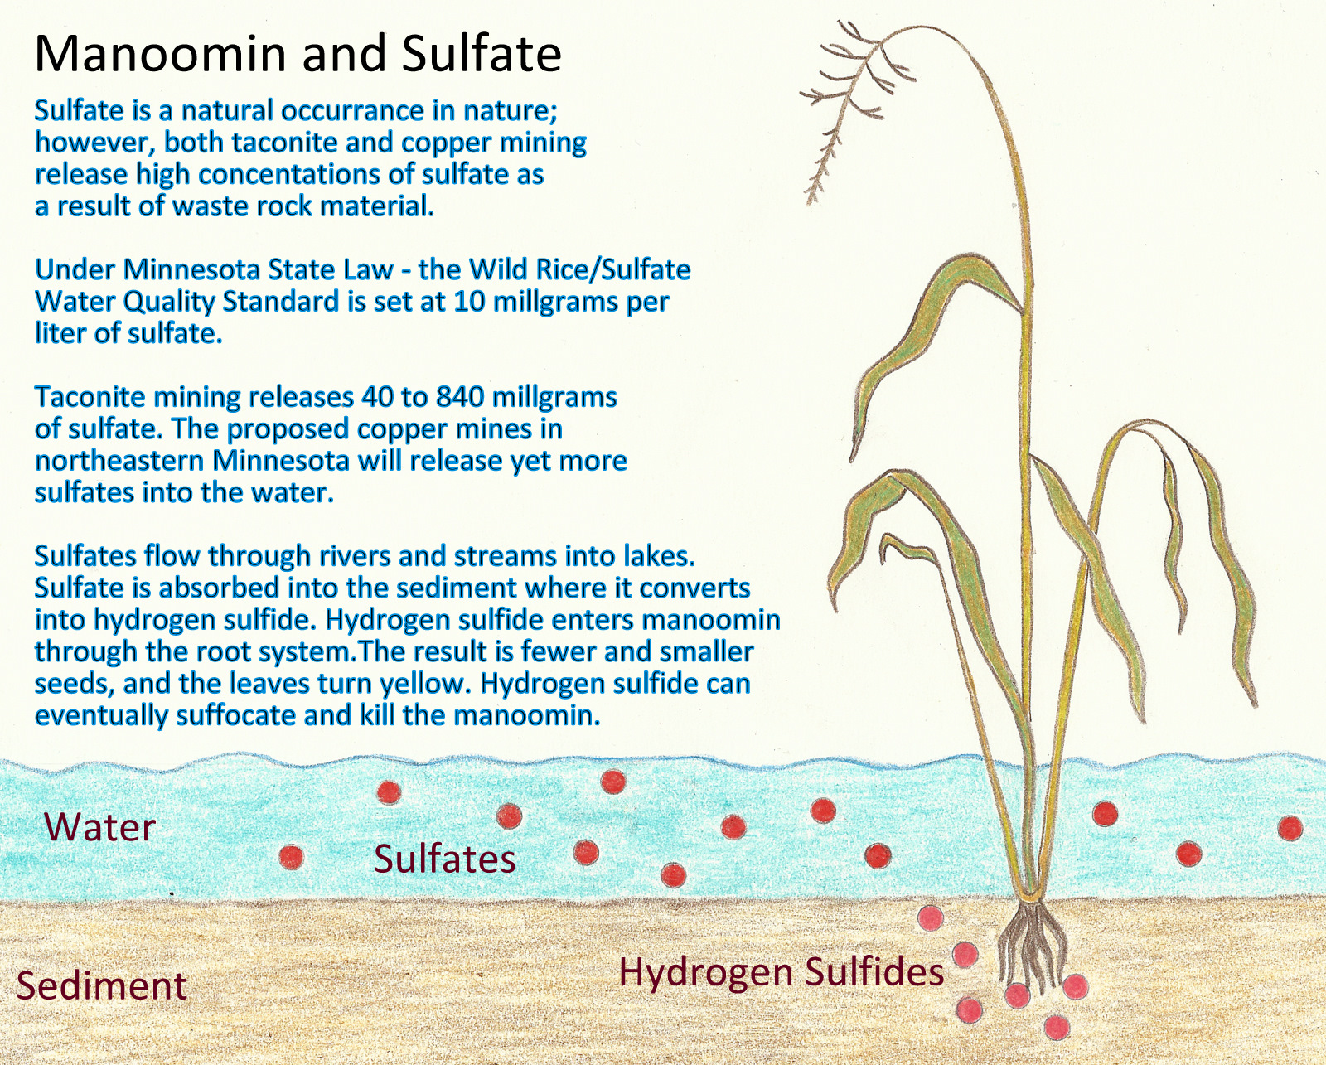

Slide 18
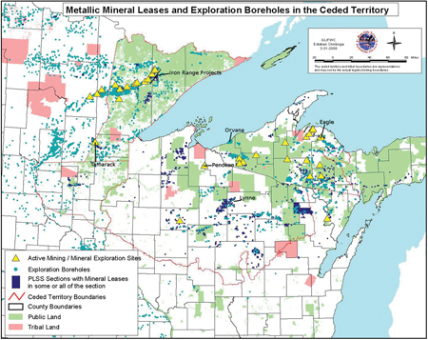
Red Lake
Bois Forte
Grand Portage
Leech Lake
Fond du Lac
Red Cliff
Lac Vieux Desert
Keweenaw Bay
y
Sandy Lake
Bad River
Lac du Flambeau
Mille Lacs
St. Croix
Lac Courte
Orielles
Mole Lake
Sokaogon

Slide 19
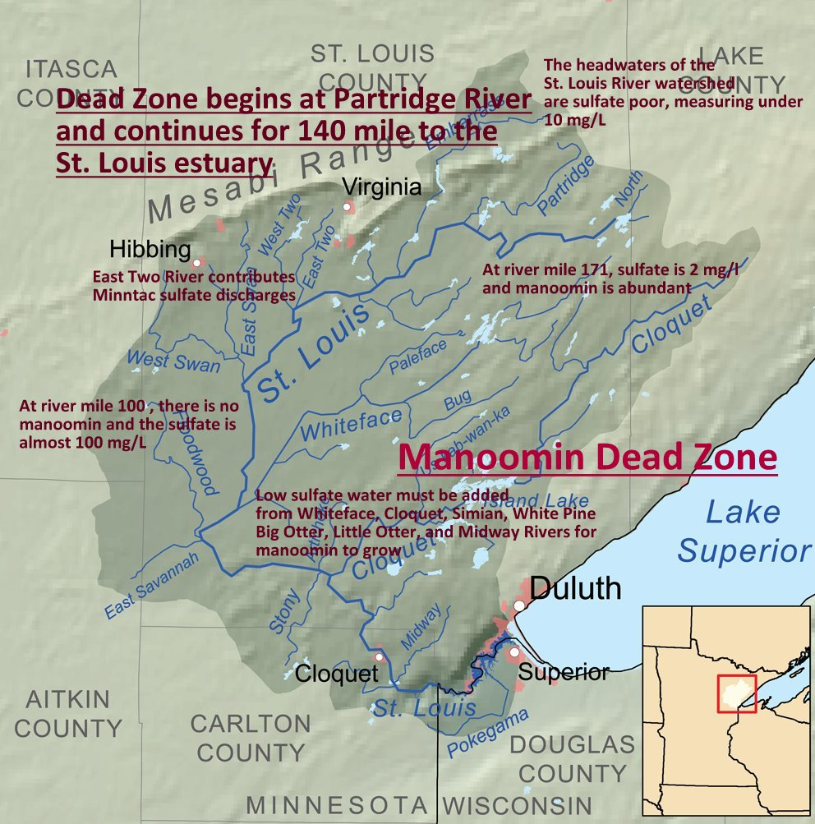

Slide 20
Legislation
In 1973, the Minnesota legislature established the Wild Rice/Sulfate Water Quality Standard of 10 mg/L – or 10 parts per million. The standard was based on the work of John Moyle, a scientist for the DNR. The standard is regulated by the Minnesota Pollution Control Agency (MPCA), and is federally approved by the Environmental Protection Agency (EPA).
In 2011, the Minnesota legislature attempted to revise the standard. For mining companies, the current standard presents an obstacle since the mining process releases high concentrations of sulfates. During the House and Senate committee process, the House revision called for raising the standard to 50 mg/L, the Senate revision called suspending the standard altogether.
The bill’s authors - Sen. Thomas Baak and Rep. David Dill received a letter from the EPA that informed the legislature that any revision would violate EPA regulations and would result in litigation.

Slide 21
In the Special Session held after the state shutdown, the legislature dropped changes to the sulfate water quality standard. However, they inserted provisions regarding water treatment. Under current policy, the MPCA is prohibited from requiring, as part of a permit issued for the discharge of waste water, an expenditure for design and implementation of sulfate water treatment technologies.
Furthermore, the Legislature mandated a $1.5 million, two-year study to determine if the sulfate water quality can be changed or raised. The MPCA is conducting the study with advisors from Anishinaabe communities, environmental groups, mining groups, and scientists from the University of Minnesota.

Slide 22
2012 Minnesota Legislative (Session 87) Bills Affecting Mining Issues
HF – House Floor / SF – Senate Floor
HF 2244/SF 1889: Permanent School Fund Advisory Committee.
HF 2169 / SF 1922: State agency rule review and reporting methods
HF 2095 / SF 1567: Environmental permitting, environmental review requirements modified.
HF 3373: Minor permits and minor permit amendments automatic approval provided, adoption of water standards more restrictive than federal standards prohibited,
deposit of monetary penalties from environmental violations required to be redirected to general fund, citizen's board created, and environmental review content requirements modified.
HF 2202 / SF 1857: Boundary Waters Canoe Area Wilderness state land expedited exchange, condemnation, and private sale provided.
HF 2393/ SF 2042: Wetland Conservation Act modified.
HF 0389 / SF 0270: Interim zoning provided, and municipal development land dedication and fees provided.

Slide 23
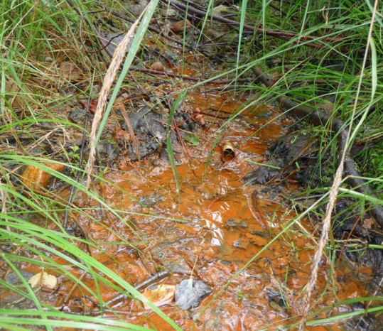
AMD at Ely, Minnesota
Acid Mine Drainage
Sulfide ores are ores containing heavy metals (such as copper or nickel) that are bonded to sulfur, forming sulfur minerals. When exposed to air and moisture, a chemical reaction
generates sulfuric acid that can be leach into the surrounding environment and cause the release of the metals into streams and lakes at levels that are toxic to fish and other aquatic life. This phenomenon is known as Acid Mine Drainage (AMD).
In a surface mine…mining leaves huge piles of waste rock and a huge pit exposed to the elements. Like the ore that has been removed, the waste rock and the pit walls contain sulfide materials. The potential for AMD and for contamination of surface and groundwater by heavy metals remains for centuries.

Slide 24
Sulfide Mining FAQs
Polymet is a foreign, Canadian extractive resource entity backed by Swiss multinational
Glencore. Glencore has been cited for human rights abuses in the Congo and Columbia.
Glencore currently owns about a quarter of PolyMet stock. Most of the copper from
PolyMet’s mine will be exported to China.
EPA: “According to [PolyMet’s) DEIS [Draft Environmental Impact Study], all waste rock at
the site is acid generating, and acidic water moving through waste rock and tailings will
mobilize metals and sulfates, leaching them into groundwater and surface water…based
on our review of the DEIS, EPA has rated the DEIS as environmentally Unsatisfactory –
Inadequate. Environmentally Unsatisfactory (EU) indicates that our review has identified
adverse environmental impacts that are of sufficient magnitude that EPA believes that
the proposed action must not proceed as proposed.” (EPA Letter / February 2010)
In the tribal response to PolyMet’s EIS, the three tribes involved - Bois Forte Band, Fond
du Lac Band), and Grand Portage Band) – cited incomplete and inadequate areas of study
and the EIS didn’t meet state or federal environmental laws. The tribes also were adamant
that the Wild Rice/Sulfate Standard be maintained to protect the manoomin.

Slide 25
The proposed mine site is within the Superior National Forest, where open pit strip mining is not allowed. PolyMet will take about 6,700 acres of public land from the Superior National Forest. Iron Range Resources provided PolyMet with a $4 million loan to buy land that will, in turn, be swapped with Superior National Forest land.
The mine will directly destroy more than 850 acres of high-quality wetlands with more than 650 additional acres of wetlands indirectly impaired. The total wetlands impact would be more than 1,500 acres. The vast majority of the required wetlands mitigation will occur outside the St. Louis River watershed. The mine will result in seepage of high sulfate concentrations and create high risk situations for mercury methylation. Methyl mercury is the active form of mercury that accumulates in fish and is toxic to humans and wildlife.
The mine is expected to generate nearly 400 million tons of waste rock and account for an annual carbon footprint of 767,648 metric tons of carbon dioxide emissions. Reactive waste rock piles would be permanently left on the land – ranging in size from 70 to 560 acres in size, and from 13 to 20 stories high. It will take 2000 years of water treatment to restore the water to the condition the water as in when the mining began.

Slide 26
The project proposes to store mine tailings and toxic waste materials in an existing mine tailings basin that has current basin stability problems. The existing basin is located at Hoyt Lakes – 50 miles from Duluth. There is over 1800 acreage of manoomin located in the Hoyt Lakes area.
The mine site is located within the 1854 Treaty Ceded Territory, where the Bois Forte, Fond du Lac, and Grand Portage Anishinaabeg Nations retain hunting, fishing and gathering off-reservation rights as affirmed under the Supreme Court decision – Minnesota v. Mille Lacs (1999).
The mining of less than 1% ores results in 99% waste rock. Mining the Duluth Complex of mineralization will ultimately destroy the most scenic part of northeast Minnesota between Lake Superior and the Boundary Waters Canoe Area Wilderness. This area includes approximately 9,000 acreage of manoomin.
Even though mining companies are required to provide financial assurance for clean-up, the record from other states shows that clean-up costs far exceed projections, with tax payers footing the bill. In addition, financial assurance does not prevent the destruction of manoomin, forests, wetlands, water quality, wildlife habitat, scenic areas, and biodiversity.

Slide 27
The metals mined will not be used for American technology. The demand for copper comes from China and is needed for building its industrial infrastructure. During this time of market disruption, China and newly industrializing countries are buying up copper and precious metals as a commodity to bolster their currency.
Copper mineralization is bonded to sulfide ores which eventually produce sulfuric acid.
In addition to sulfates, the mining process adds mercury, arsenic, and toxic heavy metals into the water.
There is no copper mine in existence that is not polluting the ground water.

Slide 28
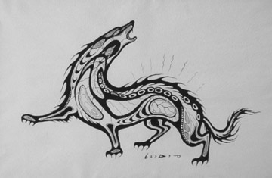
Ma’iingan
In 2011, wolves were delisted from the Endangered Species Act., a status they had received in 1974. Under the guise of “wolf management,” a number of states have passed or proposed anti-wolf legislation to hunt and kill wolves . Most biologists and other officials agree that a self-sustaining wolf population contributes to the biodiversity and ecosystem health of their native states and regions. According to Steve Williams, Director of the U.S. Fish and Wildlife Service: “The north woods of Minnesota, Wisconsin, and Michigan are healthier ecosystems because of the presence of wolves.”

Slide 29
On April 4, the Minnesota House passed a trapping and hunting bill. Under the House bill, up to 400 wolves could be taken by hunters for a limited wolf hunting season.
According to Sen. Scott Dibble: “[T]his bad idea, and [I] will work to see that a moratorium is placed on a wolf hunting season until better planning supported by sound data can be completed. There is no reason to rush into creating a wolf hunting and trapping season. Owners of livestock, guard animals, and domestic animals are already allowed to shoot wolves that pose a threat to their animals. “
Rep. Kerry Gauthier also oppose the anti-wolf bill. Gauthier said: “When we make laws, we make laws for all the people of Minnesota”
Gauthier suggested that greater sensitivity should be shown to the religious beliefs of others. And the wolf has religious significance to Native Americans, he explained.

Slide 30
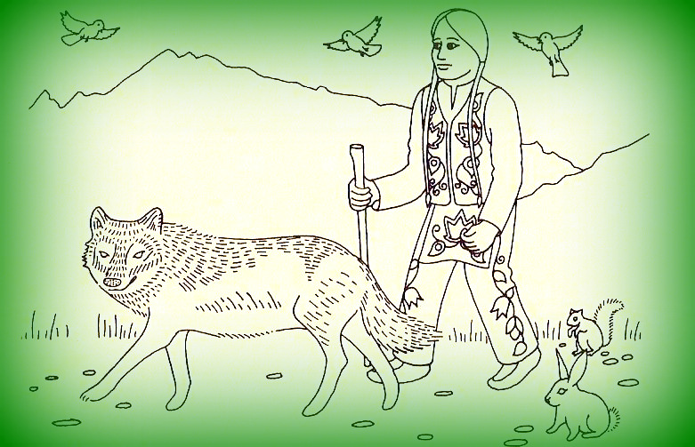
Original Man and Ma’iingan
“In the Anishinaabe creation story we are taught that Ma’iingan (wolf)
is a brother to Original man.”

Slide 31
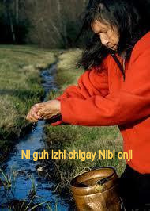
Nibi
This isn't an Indian issue, nor is it a white issue. It's everybody's issue. Everybody has to take care of that water. The women are the ones who are the keepers of that water. I ask all women to stand up and support that and realize that if it wasn't for the water none of us would be here today because when we first started out in life, we were born in that water in our mother's womb. And I'll bet you everybody here turned on that water today to do something with it. And that's what they're going to pollute. That's what they're going to destroy. I'm not going to have any more wild rice if that water drops down three feet from the mine dewatering. That is important to my way of life -- to all Anishinabes' way of life. And they're taking that away -- they're going to destroy our way of life.
~ Francis Van Zile

Slide 32
The Seventh Fire
In the time of the Seventh Fire a New People will emerge. They will retrace their steps to find what was left by the trail. Their steps will take them to the Elders who they will ask to guide them on their journey. But many of the Elders will have fallen asleep. They will awaken to this new time with nothing to offer. Some of the Elders will be silent because no one will ask anything of them. The New People will have to be careful in how they approach the Elders. The task of the New People will not be easy.
It is this time that the light skinned race will be given a choice between two roads. If they choose the right road, then the Seventh Fire will light the Eighth and final Fire, an eternal fire of peace, love brotherhood and sisterhood. If the light skinned race makes the wrong choice of the roads, then the destruction which they brought with them in coming to this country will come back at them and cause much suffering and death to all the Earth's people.
The time of the Seventh Fire is now.

Slide 33
For more information:
www.protectourmanoomin.org
E-mail:
r_desjarlait@protectourmanoomin.com

